Slide 1


WEEK 12
Neural Networks & Generative AI
Computer Modelling
Technical University of Košice • Faculty of Electrical Engineering and Informatics
Notes:
Welcome to Week 12! Today we cover the final major topics: generative models. KEY POINTS: • This lecture bridges fundamentals with cutting-edge AI • We'll cover VAEs, GANs, Diffusion Models, Transformers, and Self-Supervised Learning • These are the building blocks of DALL-E, Stable Diffusion, ChatGPT, and modern AI

Slide 2

What We Have Learned
NEURAL NETWORK FUNDAMENTALS
ACTIVATION FUNCTIONS
TRAINING PROCESS
Perceptron / MLP Architecture
Sigmoid: σ(x) = 1/(1+e⁻ˣ)
Forward Propagation
Convolutional Layers
Tanh: (eˣ-e⁻ˣ)/(eˣ+e⁻ˣ)
Backpropagation
Normalization Layers
ReLU: max(0, x)
Gradient Descent (SGD, Adam)
Weight Initialization
LeakyReLU, GELU, Swish
Learning Rate Scheduling
Computational Graphs
Softmax for classification
Regularization Techniques
Key Insight: Deep Learning differs from traditional ML through automatic feature learning via hierarchical representations
Notes:
Quick recap of what we've learned so far. REVIEW: • Perceptrons are the basic unit - weighted sum + activation • MLPs stack layers for non-linear function approximation • CNNs use spatial inductive biases for images • Proper initialization prevents vanishing/exploding gradients TRANSITION: Now we'll use these building blocks for GENERATION, not just classification.

Slide 3
What We Have Learned
NEURAL NETWORK FUNDAMENTALS
Key Insight: Deep Learning differs from traditional ML through automatic feature learning via hierarchical representations
Notes:
Quick recap of what we've learned so far. REVIEW: • Perceptrons are the basic unit - weighted sum + activation • MLPs stack layers for non-linear function approximation • CNNs use spatial inductive biases for images • Proper initialization prevents vanishing/exploding gradients TRANSITION: Now we'll use these building blocks for GENERATION, not just classification.

Slide 4
Loss Functions and Optimization
REGRESSION
SEGMENTATION LOSSES
MSE: L = (1/n)Σ(yᵢ - ŷᵢ)²
Dice Loss
MAE: L = (1/n)Σ|yᵢ - ŷᵢ|
L = 1 - (2|X∩Y|)/(|X|+|Y|)
Soft Dice
Differentiable version for training
CLASSIFICATION
Tversky Loss
BCE: L = -[y·log(p) + (1-y)·log(1-p)]
Weighted FP/FN: α·FP + β·FN
CE: L = -Σyᵢ·log(pᵢ)
Compound Loss
CE + Dice for balanced training
GENERATIVE
KL Divergence: DKL(P||Q)
OPTIMIZERS
Adversarial: Min-Max Game
SGD → Momentum → Adam → AdamW
Notes:
Loss functions are how we tell the network what we want. KEY INSIGHTS: • MSE for regression - penalizes large errors more (squared) • Cross-entropy for classification - measures distribution difference • Dice loss for segmentation - handles class imbalance naturally • For generative models: KL divergence measures distribution similarity PRACTICAL TIP: Compound losses (CE + Dice) often work best for medical segmentation.

Slide 5

Training Components
Weight Initialization
Computational Graph and Backpropagation
Xavier/Glorot: Var(W) = 2/(nᵢₙ + nₒᵤₜ)
He/Kaiming: Var(W) = 2/nᵢₙ
Proper initialization prevents vanishing/exploding gradients
Input x
→
Linear
→
ReLU
→
Loss
Regularization
Forward Pass: Compute output from input
L1/L2 Weight Decay
Backward Pass: Compute gradients via chain rule
Dropout (p = 0.1-0.5)
Data Augmentation
Early Stopping
Chain Rule: ∂L/∂w = ∂L/∂y · ∂y/∂w
Notes:
Training components that make deep learning work. INITIALIZATION: • Xavier/Glorot: Good for sigmoid/tanh - keeps variance stable • He/Kaiming: Designed for ReLU - accounts for half the neurons being zero REGULARIZATION: • L2 (weight decay): Prevents weights from growing too large • Dropout: Forces redundancy, like training an ensemble • Data augmentation: The most powerful regularizer - more data!

Slide 6

Convolutional Neural Networks
Inductive Biases: Translation equivariance, local connectivity, parameter sharing → efficient feature learning
No Padding, No Stride
Padding, No Stride
No Padding, Stride=2
4×4 → 3×3 (k=2)
Same size preserved
Downsampling 2×
Conv2D
BatchNorm
ReLU
MaxPool
Linear
Notes:
Convolutions are the key to efficient image processing. INDUCTIVE BIASES: • Translation equivariance: A cat is a cat regardless of position • Local connectivity: Nearby pixels are more related • Parameter sharing: Same filter applied everywhere ARCHITECTURE PATTERNS: • Conv → BatchNorm → ReLU is the standard block • Stride or pooling for downsampling • More channels as spatial size decreases

Slide 7
U-Net: Encoder-Decoder Architecture
Input 256×256
32×32
← Skip Connections →
↑ UpConv
Concatenate features
↓ Conv+Pool
↓
64×64
128×128
Bottleneck
16×16
↑ UpConv
↓ Conv+Pool
128×128
64×64
↓
↑ UpConv
↓ Conv+Pool
32×32
Output 256×256
Encoder (Contracting)
Bottleneck
Decoder (Expanding)
Extract hierarchical features, reduce spatial dims
Compressed representation, global context
Reconstruct spatial resolution with skip connections
Notes:
U-Net: The workhorse of medical image segmentation. KEY INNOVATION: Skip connections! • Encoder loses spatial detail but gains semantic understanding • Decoder needs that spatial detail back • Skip connections provide a "shortcut" for fine details PRACTICAL NOTE: • U-Net works with very few training samples • Standard in medical imaging since 2015 • Still competitive with transformers for many tasks

Slide 8
PART II
Generative Models
Learning to generate new data samples
VAEs • GANs • Diffusion Models
VAE
GAN
Diffusion
Probabilistic latent space, smooth interpolation
Adversarial training, sharp outputs
Iterative denoising, state-of-the-art quality
Notes:
Section transition: Now we enter GENERATIVE models. FUNDAMENTAL QUESTION: How do we generate NEW data? THREE APPROACHES: 1. VAE: Learn a probabilistic latent space, sample and decode 2. GAN: Train a generator to fool a discriminator 3. Diffusion: Iteratively denoise random noise into data

Slide 9
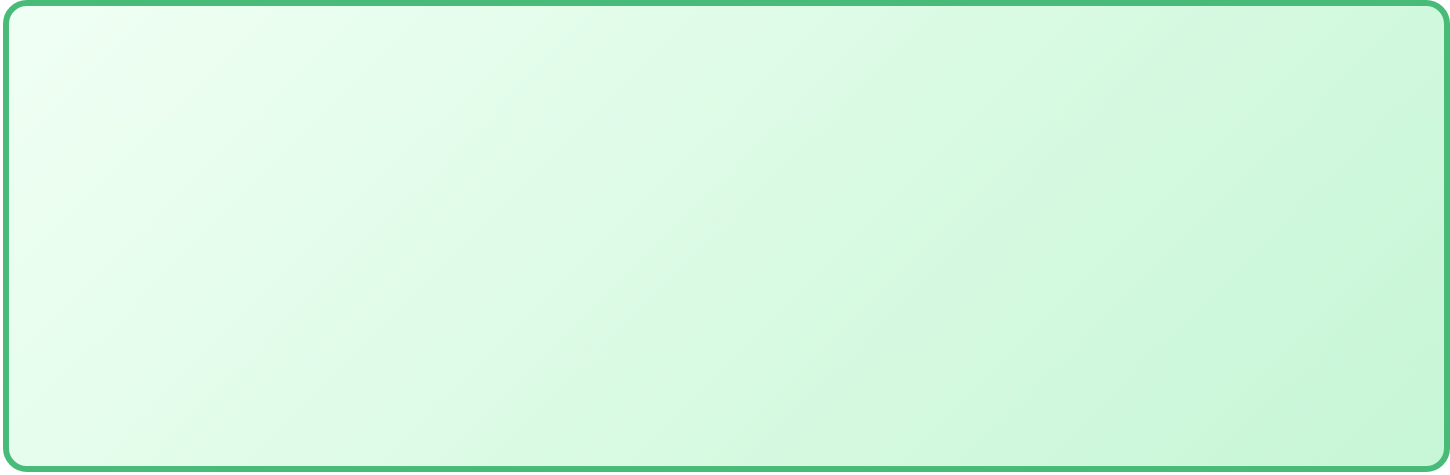











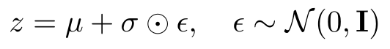
VAE Architecture: Learning Probabilistic Latent Spaces
STANDARD AUTOENCODER
VARIATIONAL AUTOENCODER
x
→
Encoder
→
z
→
Decoder
→
x̂
x
→
Encoder
→
μ
→
z
→
Decoder
→
x̂
σ²
z ~ N(μ,σ²)
⚠ Deterministic z — cannot sample new data
✓ Probabilistic z — can sample new data!
VAE Loss Function (ELBO)
Reconstruction Loss
KL Divergence
β Weight
How well can we rebuild x from z?
Force q(z|x) close to N(0,1)
Balance reconstruction vs regularization
Reparameterization Trick
Why KL Regularization?
Prevents "holes" in latent space. Creates smooth, continuous manifold for meaningful interpolation.
Makes sampling differentiable for backpropagation.
Notes:
VAE is the first truly generative deep learning model. THE KEY INSIGHT: • Standard autoencoder: z is a single point - can't sample meaningfully • VAE: z is a DISTRIBUTION (mean + variance) - can sample new points! THE LOSS FUNCTION: • Reconstruction: Make sure we can rebuild the input • KL Divergence: Force the latent space to be "nice" (close to N(0,1)) • β controls the trade-off (higher β = smoother latent space, blurrier outputs) REPARAMETERIZATION TRICK: z = μ + σ*ε allows backprop through sampling.

Slide 10
VAE Architecture: Learning Probabilistic Latent Spaces
Notes:
VAE is the first truly generative deep learning model. THE KEY INSIGHT: • Standard autoencoder: z is a single point - can't sample meaningfully • VAE: z is a DISTRIBUTION (mean + variance) - can sample new points! THE LOSS FUNCTION: • Reconstruction: Make sure we can rebuild the input • KL Divergence: Force the latent space to be "nice" (close to N(0,1)) • β controls the trade-off (higher β = smoother latent space, blurrier outputs) REPARAMETERIZATION TRICK: z = μ + σ*ε allows backprop through sampling.

Slide 11
Latent Space Structure
Continuous & Smooth
2D Latent Space Visualization
Nearby points decode to similar outputs. Small changes in z produce gradual variations in generated samples.
Semantic Organization
Latent dimensions often capture interpretable features: style, pose, color, shape variations.
z₂
Regularization via KL
KL divergence encourages q(z|x) ≈ N(0, I), preventing sparse regions and enabling sampling.
z₁
Semantic clusters form naturally
Key Benefit
Sample z ~ N(0, I) → Decode → Generate new, realistic data
Notes:
The latent space is where the magic happens. WHAT KL REGULARIZATION DOES: • Without it: Encoder puts each class in a tiny isolated region • With it: Forces distributions to overlap with N(0,1) • Result: Continuous, smooth manifold WHY THIS MATTERS: • Can interpolate between any two points • Random samples decode to valid images • Latent directions often correspond to semantic attributes

Slide 12
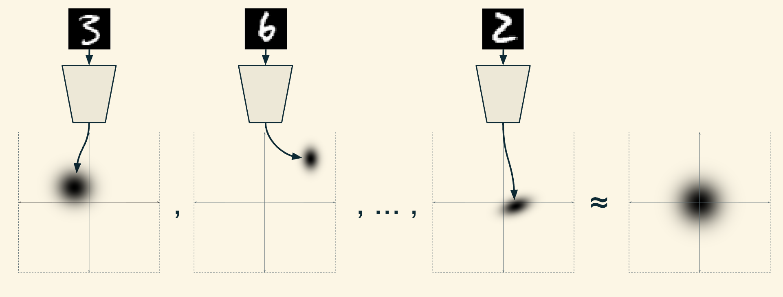
Latent Space Structure
Notes:
The latent space is where the magic happens. WHAT KL REGULARIZATION DOES: • Without it: Encoder puts each class in a tiny isolated region • With it: Forces distributions to overlap with N(0,1) • Result: Continuous, smooth manifold WHY THIS MATTERS: • Can interpolate between any two points • Random samples decode to valid images • Latent directions often correspond to semantic attributes

Slide 13



Latent Space Interpolation
Linear Interpolation: z = (1-α)·z₁ + α·z₂
Face A
Face B
→
0.25
→
0.50
→
0.75
→
α = 0
α = 1
Smooth transitions through latent space produce realistic intermediate samples
Linear (Lerp)
Spherical (Slerp)
Applications
z = (1-α)z₁ + αz₂
Interpolate along geodesic on hypersphere
Morphing, style transfer, attribute manipulation, data augmentation
Simple but may pass through low-density regions
Better for high-dimensional latent spaces
Notes:
Interpolation is one of the coolest VAE applications. LINEAR vs SPHERICAL: • Linear (Lerp): Simple, works okay • Spherical (Slerp): Better for high-dimensional spaces APPLICATIONS: • Image morphing between faces • Style transfer • Attribute manipulation (make face older, add glasses)

Slide 14

Conditional VAE: Training
x (image)
Encoder
μ
z
Decoder
→
→
→
z
→
→
→
x̂
q(z|x,y)
σ²
y
p(x|z,y)
y (label)
CVAE Loss
Key Difference
Both encoder and decoder receive class label y, enabling class-conditional generation
Notes:
Conditional VAE gives us CONTROL over generation. KEY MODIFICATION: • Both encoder and decoder receive the class label y • Encoder: q(z|x,y) - "given this image and its label, what's z?" • Decoder: p(x|z,y) - "given z and a label, generate an image" WHY CONDITION BOTH? • Encoder: Helps separate class-specific from class-independent features • Decoder: Tells it WHAT to generate

Slide 15

Sampling from CVAE
Generation Process (No Encoder Needed)
1
2
3
✓
+
→
→
Choose y
(class)
Sample z
~ N(0,I)
Decoder
p(x|z,y)
Generated
Image
Controlled Generation
Diverse Samples
Applications
Specify class label → generate samples of that class
Different z values → different variations within class
Data augmentation, image editing, style transfer
Notes:
CVAE sampling gives controlled generation. THE PROCESS: 1. Choose the class you want (e.g., digit "7") 2. Sample z from standard normal 3. Decoder uses both z and class label 4. Output: A new "7" we've never seen before! DIVERSITY: Same class + different z = different variations.

Slide 16
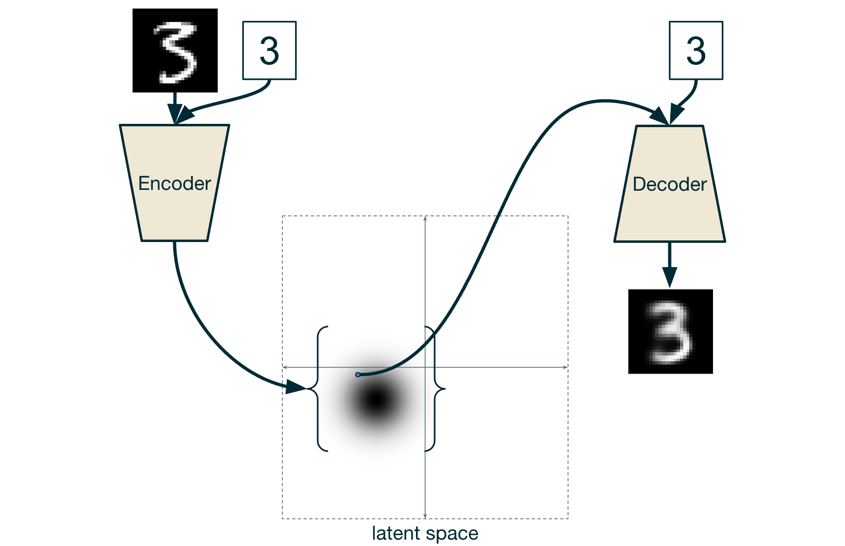
Sampling from CVAE
Notes:
CVAE sampling gives controlled generation. THE PROCESS: 1. Choose the class you want (e.g., digit "7") 2. Sample z from standard normal 3. Decoder uses both z and class label 4. Output: A new "7" we've never seen before! DIVERSITY: Same class + different z = different variations.

Slide 17
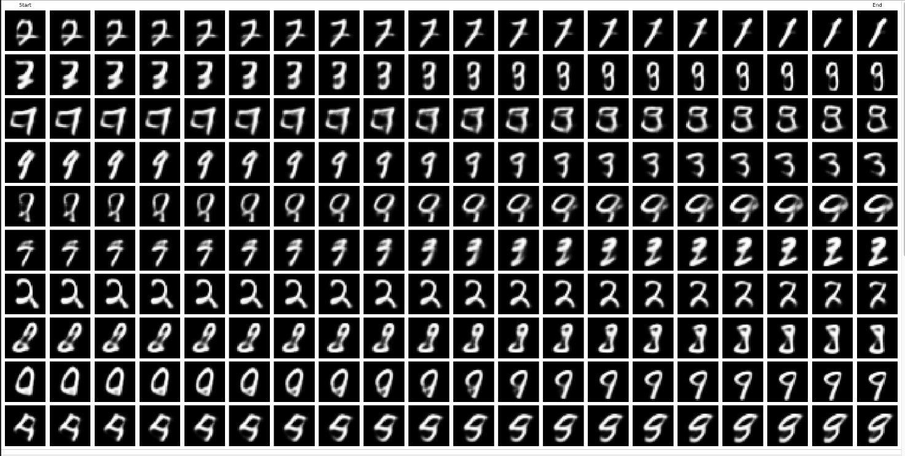
Sampling from CVAE
Notes:
CVAE sampling gives controlled generation. THE PROCESS: 1. Choose the class you want (e.g., digit "7") 2. Sample z from standard normal 3. Decoder uses both z and class label 4. Output: A new "7" we've never seen before! DIVERSITY: Same class + different z = different variations.

Slide 18
CVAE Applications and Results
Medical Imaging
MNIST Digit Generation
Generate pathology-specific samples
Augment rare disease cases
Synthesize missing modalities
0
1
2
3
4
Face Generation
Condition on attributes (age, gender)
Expression manipulation
5
6
7
8
9
Pose-conditioned synthesis
Condition on y to generate specific digits
Limitation
VAE outputs can be blurry due to MSE reconstruction loss. GANs produce sharper results.
Notes:
CVAE has real practical applications. MEDICAL IMAGING: • Generate rare pathologies for training • Augment small datasets • Synthesize missing modalities (MRI from CT) LIMITATIONS: • MSE reconstruction loss → blurry outputs • This is why GANs became popular - they produce SHARP images

Slide 19

PART III
Generative Adversarial Networks
The Adversarial Game
Generator vs. Discriminator
Core Idea: Two networks compete — a Generator creates fake data while a Discriminator learns to distinguish real from fake. Through this adversarial game, the Generator learns to produce increasingly realistic samples.
Notes:
Section transition: GANs - a completely different approach. THE ADVERSARIAL IDEA (Goodfellow 2014): • What if we trained a "critic" to judge quality? • Generator tries to fool the critic • They improve together through competition ANALOGY: Counterfeiter vs. Police • Counterfeiter (G) tries to make fake money • Police (D) tries to detect fakes • Both get better over time

Slide 20
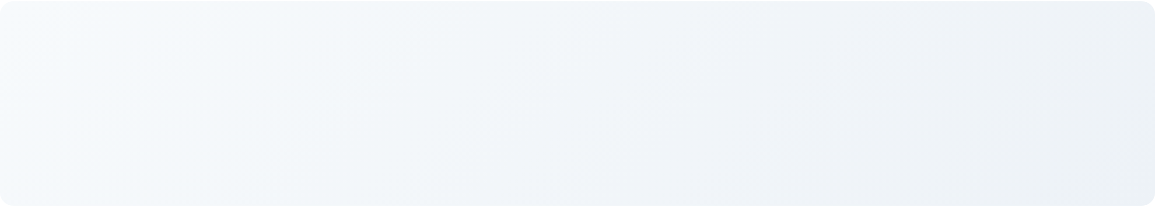






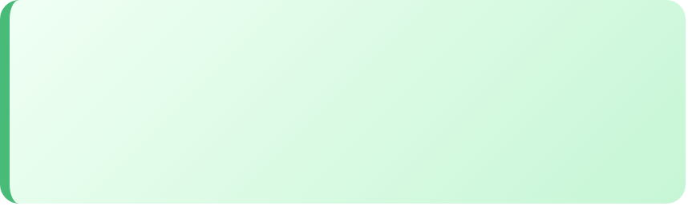

GAN Architecture: The Adversarial Game
z ~ N(0,I)
Generator
↘
Discriminator
D(x)
→
G(z)
→
x_fake
D(x)
→
∈ [0,1]
↗
Random noise
Creates fake data
Generated
Real or Fake?
Probability
Real data
x_real
Generator G
Discriminator D
Adversarial Game
Maps noise z to data space
Binary classifier: real vs fake
G and D compete, driving improvement
Goal: Fool D by producing x_fake that looks real
Goal: D(x_real)→1, D(x_fake)→0
Equilibrium: G produces realistic data
Notes:
GAN architecture - two networks competing. GENERATOR: • Input: Random noise z (e.g., 100-dimensional) • Output: Fake image in data space • Architecture: Typically transposed convolutions DISCRIMINATOR: • Input: Image (real or fake) • Output: Probability it's real • Architecture: Standard CNN classifier KEY: They share NO weights - completely separate networks.

Slide 21

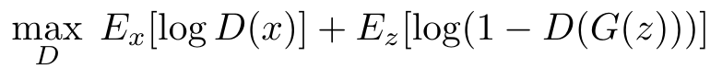
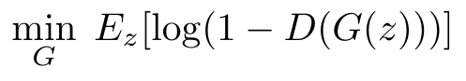

The Minimax Objective
Discriminator (Maximizes)
Generator (Minimizes)
Goal:
Goal:
D(x) → 1 for real samples
D(G(z)) → 1 (fool discriminator)
D(G(z)) → 0 for fake samples
In practice: maximize log D(G(z))
Maximize both log terms
Nash Equilibrium:
p_G = p_data and D(x) = 0.5 → Generator perfectly mimics real data
Notes:
The minimax objective is the mathematical heart of GANs. INTUITION: • D wants to maximize: correctly classify real (high) and fake (low) • G wants to minimize: make D think fakes are real NASH EQUILIBRIUM: • When G perfectly matches the real data distribution • D outputs 0.5 for everything (can't tell the difference)

Slide 22
Training Algorithm
Hyperparameters
Train Discriminator (k steps)
k = 1-5 (D steps per G step)
1
lr = 0.0002 (Adam)
Sample minibatch {x₁...xₘ} from real data
β₁ = 0.5, β₂ = 0.999
Sample minibatch {z₁...zₘ} from noise prior
batch = 64-128
Update D by ascending: ∇[log D(x) + log(1-D(G(z)))]
Training Tips
2
Train Generator (1 step)
Label smoothing (0.9 vs 1.0)
Normalize inputs to [-1, 1]
Sample minibatch {z₁...zₘ} from noise prior
LeakyReLU in D (α=0.2)
Update G by descending: ∇ log(1-D(G(z)))
BatchNorm in both G and D
Or maximize log D(G(z)) for stronger gradients
Common Pitfalls
Repeat until convergence
D too strong: G cannot learn
G too strong: mode collapse
Notes:
GAN training is notoriously tricky. PRACTICAL TIPS: • Train D for k steps, then G for 1 step (k=1-5 typical) • Use Adam with lr=0.0002, β1=0.5 • Label smoothing: Use 0.9 instead of 1.0 for real labels • LeakyReLU in D, ReLU in G • BatchNorm in both (but not in D's first/last layer) THE BALANCE: D must be good enough to provide signal, but not so good G can't learn.

Slide 23

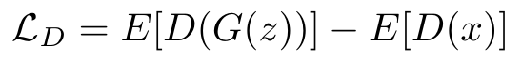
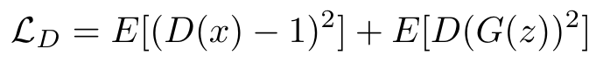

GAN Loss Functions
Standard GAN (BCE)
Wasserstein GAN
Binary cross-entropy loss
Earth mover distance
Prone to vanishing gradients
Stable training, meaningful loss
Least Squares GAN
Hinge Loss
MSE instead of BCE
SVM-inspired margin loss
Penalizes far from boundary
Used in BigGAN, StyleGAN
Standard: Original, unstable
WGAN: Most stable
LSGAN: Good quality
Hinge: SOTA models
Notes:
Different loss functions for different problems. STANDARD GAN: BCE loss - original, but vanishing gradients when D is too good WGAN: Wasserstein distance - meaningful loss values, stable training LSGAN: Least squares - penalizes samples far from decision boundary HINGE: Used in BigGAN, StyleGAN - state-of-the-art results

Slide 24
Training Challenges and Solutions
Mode Collapse
Problem: Generator produces limited variety, ignoring modes of data distribution
Solutions: Minibatch discrimination, unrolled GANs, feature matching, WGAN loss
All same output
Vanishing Gradients
∇ → 0
Problem: When D is too good, D(G(z)) approaches 0, causing near-zero gradient
Solutions: Non-saturating loss: maximize log D(G(z)) instead, or use WGAN
No learning signal
Training Instability
↑↓↑↓
Problem: Losses oscillate wildly, no clear convergence, sensitive to hyperparameters
Solutions: TTUR (different lr for G/D), spectral normalization, progressive growing
Oscillating loss
Evaluation Metrics
FID (lower is better)
IS (higher is better)
LPIPS (lower is better)
KID (lower is better)
Fréchet Inception Distance
Inception Score
Perceptual similarity
Kernel Inception Distance
Notes:
GAN training challenges - what can go wrong. MODE COLLAPSE: G finds one image that fools D and keeps producing it • Solution: Minibatch discrimination, feature matching VANISHING GRADIENTS: D gets too good → G receives no learning signal • Solution: Non-saturating loss, WGAN EVALUATION: FID score measures quality AND diversity.

Slide 25
Popular GAN Variants
DCGAN (2016)
WGAN-GP (2017)
StyleGAN (2019)
Deep Convolutional GAN
Wasserstein + Gradient Penalty
Style-based Generator
Conv layers, BatchNorm, strided convs. Foundation for modern GANs.
Earth mover distance, gradient penalty instead of clipping. Very stable.
Mapping network z→w, AdaIN layers. High-res photorealistic faces.
cGAN (2014)
CycleGAN (2017)
BigGAN (2019)
Conditional GAN
Unpaired Image Translation
Large Scale GAN
Class conditioning: G(z,y), D(x,y). Enables controlled generation.
Cycle consistency loss. Horse↔Zebra, Summer↔Winter without pairs.
Massive batch sizes, class-conditional. ImageNet 512×512 SOTA.
2014
→
2016
→
2017
→
2019
→
2020+
Original GAN
DCGAN
WGAN
StyleGAN
StyleGAN2/3
Notes:
Evolution of GAN architectures. DCGAN (2016): First stable deep GAN - all-convolutional, BatchNorm, foundation for everything StyleGAN (2019): Photorealistic faces - mapping network, AdaIN, progressive training MEDICAL: Pix2Pix for image translation, CycleGAN for unpaired data.

Slide 26

Conditional GAN (cGAN)
Applications
Class-Conditional Synthesis
Architecture
Generate specific categories: digits, objects, faces with attributes
z
→
G(z,y)
→
x̂
→
D(x,y)
Image-to-Image (Pix2Pix)
y
Edges→Photo, Sketch→Render, Day→Night, Segmentation→Image
Objective
Text-to-Image
StackGAN, AttnGAN: Generate images from text descriptions
Super Resolution
Label Embedding
SRGAN, ESRGAN: Upscale low-res images with realistic detail
One-hot → Embedding layer → Concatenate with z or use FiLM conditioning
Semantic Synthesis (SPADE)
Segmentation map → Photorealistic scene
Notes:
Conditional GAN for controlled generation. HOW TO CONDITION: • Concatenate label to z for generator • Concatenate label to image for discriminator • Or: Use embedding + FiLM (feature-wise linear modulation) APPLICATIONS: • Class-conditional: Generate specific categories • Image-to-image: Pix2Pix for segmentation→image • Super-resolution: SRGAN, ESRGAN

Slide 27

PART IV
Diffusion Models
State-of-the-Art Generative Models
DDPM • Stable Diffusion • DALL-E
Core Idea: Gradually add noise to data, then learn to reverse the process. Generate new samples by starting from pure noise and iteratively denoising.
Notes:
Section transition: Diffusion Models - the new SOTA. THE BIG PICTURE: • VAE: Blurry but fast • GAN: Sharp but unstable • Diffusion: Best quality, but slower THIS POWERS: DALL-E 2, Stable Diffusion, Midjourney, Imagen

Slide 28


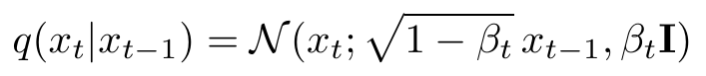


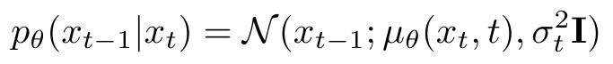
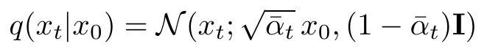
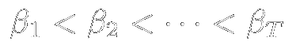
Forward and Reverse Diffusion
x₀
clean
→
x₁
→
...
→
xₜ
noisy
→
x_T
noise
Forward: — Add noise gradually
x_T
noise
→
xₜ
→
...
→
x₁
→
x₀
generated
Reverse: — Learn to denoise
Forward (Fixed)
Reverse (Learned)
Noise Schedule
Closed-form: sample any t directly
Network predicts mean μ_θ
Linear or cosine schedule
Notes:
The diffusion process - forward and reverse. FORWARD PROCESS (fixed, no learning): • Gradually add Gaussian noise over T steps • After T steps: pure noise, no information left REVERSE PROCESS (learned): • Start from noise, iteratively denoise • Neural network predicts the noise at each step

Slide 29
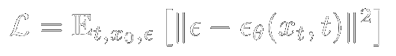
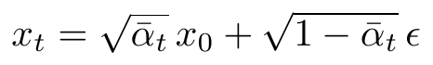
DDPM Training Objective
Key Insight: Predict the Noise
Instead of predicting x₀ or μ, predict the noise ε that was added
Training Algorithm
Sampling (Generation)
1
Sample x₀ from data, t ~ Uniform(1,T)
1
Start with x_T ~ N(0, I)
2
Sample noise ε ~ N(0, I)
2
For t = T, T-1, ..., 1:
3
Create noisy:
3
Predict noise: ε̂ = ε_θ(xₜ, t)
4
Gradient step on ||ε - ε_θ(xₜ, t)||²
4
Denoise: xₜ₋₁ = f(xₜ, ε̂, t) + σₜz
Architecture: U-Net with time embedding. Timestep t is embedded via sinusoidal encoding and added/concatenated to feature maps. Attention layers at lower resolutions.
Notes:
DDPM training is surprisingly simple. THE TRICK: • Don't predict the clean image • Don't predict the mean • Predict the NOISE that was added! ARCHITECTURE: U-Net with time embedding (sinusoidal, like positional encoding).

Slide 30
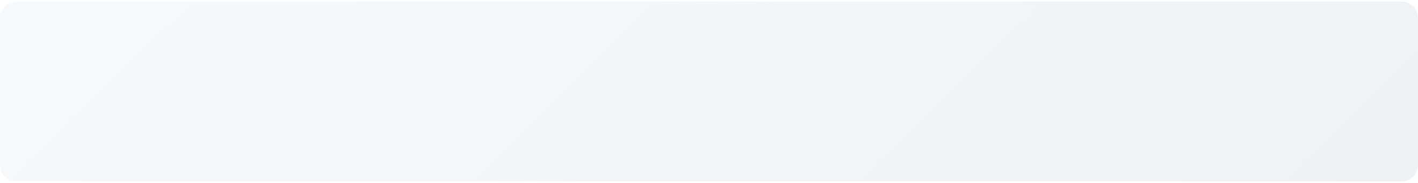

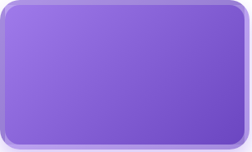




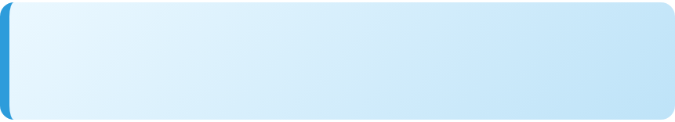


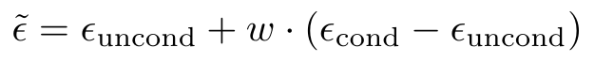
Latent Diffusion: Stable Diffusion Architecture
"a cat on Mars"
U-Net
↘
z_T
→
→
VAE
→
512×512
CLIP
Denoise × T steps
Dec
noise
64→512
Output
Text Encoder
64×64×4 latent
Latent Space Diffusion
Cross-Attention Conditioning
Classifier-Free Guidance
Denoise in 64×64×4 instead of 512×512×3. 64× less compute!
CLIP embeddings attend to U-Net features. Text guides generation.
Typical w = 7.5
Generative Models Comparison
VAE
GAN
Diffusion
Latent Diffusion ★
Fast training
Sharp images
Best quality
Best quality
Blurry outputs
Unstable training
Slow sampling
Efficient!
Notes:
Latent Diffusion / Stable Diffusion - efficiency breakthrough. THE PROBLEM: Diffusion in pixel space is expensive (512×512×3) THE SOLUTION: • First compress to latent space with VAE (64×64×4) • Do diffusion in latent space (64× less compute!) • Decode back to pixels at the end TEXT CONDITIONING: CLIP encodes text, cross-attention in U-Net. CLASSIFIER-FREE GUIDANCE: Interpolate conditional and unconditional for stronger text following.

Slide 31

PART V
Transformers and Attention
Attention Is All You Need
Self-Attention • Multi-Head • Vision Transformer
Core Idea: Replace recurrence and convolutions with self-attention. Each position can directly attend to all other positions, enabling parallel computation and capturing long-range dependencies.
Notes:
Section transition: Transformers - attention is all you need. REVOLUTION (2017): • Replaced RNNs entirely with attention • Parallel computation • Captures long-range dependencies directly NOW EVERYWHERE: GPT, BERT, ViT, CLIP, modern diffusion models

Slide 32

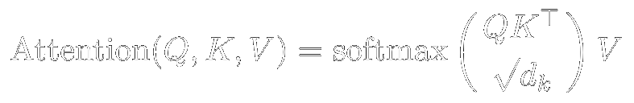
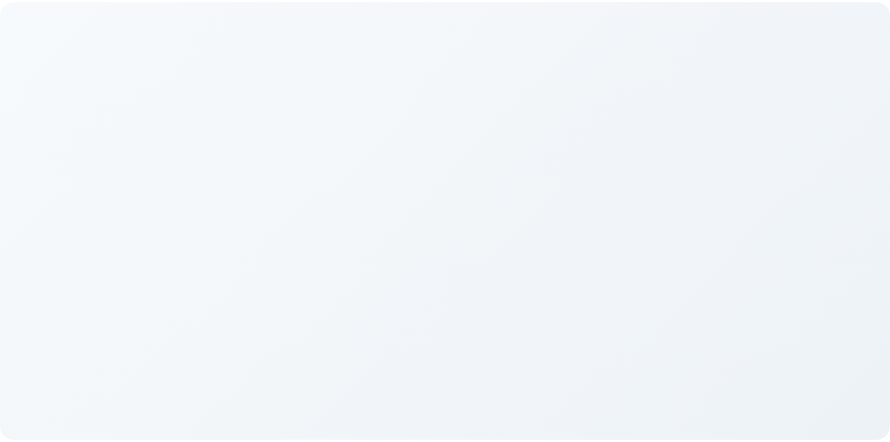
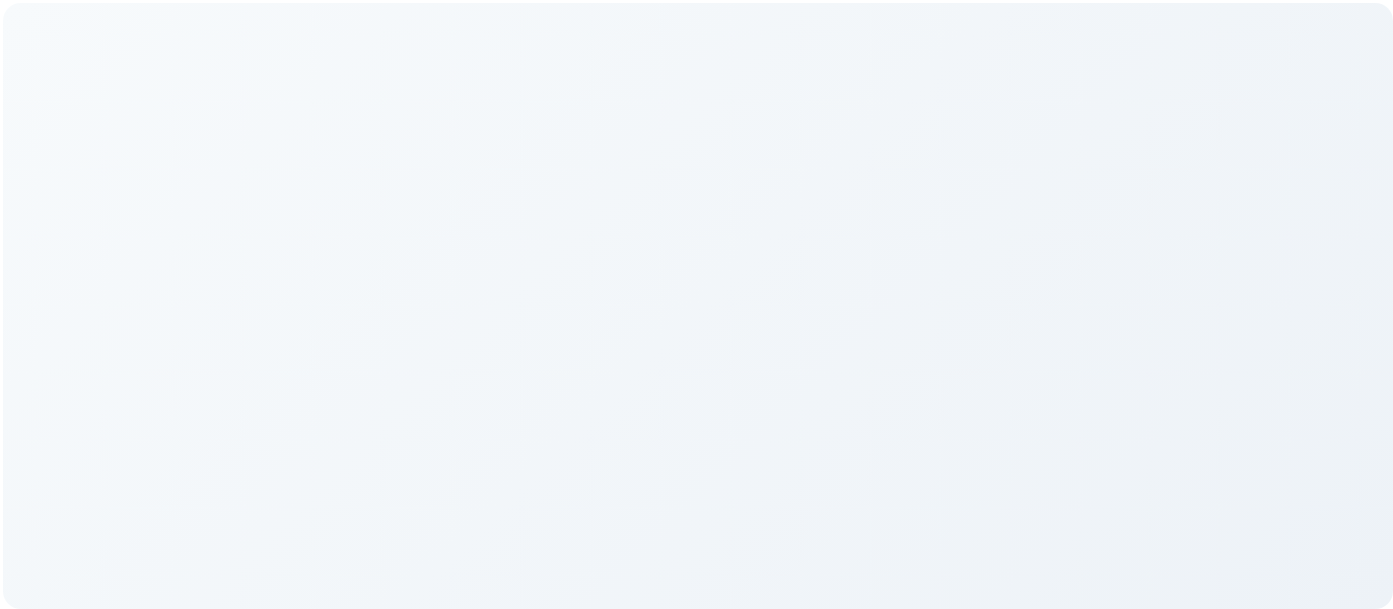






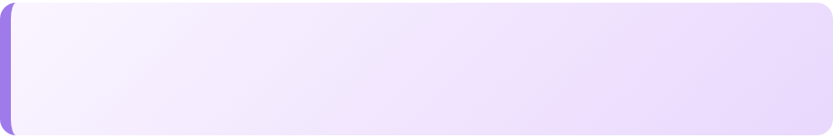
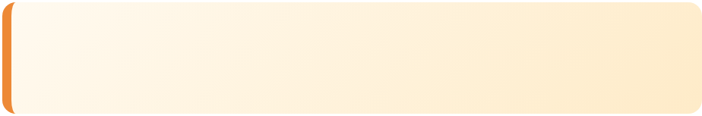
Self-Attention: The Core Mechanism
Step 1: Generate Q, K, V
Step 2: Compute Attention
Q = XW_q
1
Scores: QKᵀ → similarity
X
→
K = XW_k
V = XW_v
2
Scale: ÷√d_k (stability)
Q: What am I looking for?
3
Softmax: attention weights
K: What do I contain?
V: What info do I provide?
4
Output: weighted sum of V
Multi-Head Attention
Positional Encoding
Complexity
h=8 parallel heads, each learns different patterns. Concat → Linear.
Sinusoidal or learned embeddings. Attention is permutation invariant!
O(n²d) — quadratic in sequence length.
Notes:
Self-attention - every position talks to every other. THE COMPUTATION: 1. Project input to Q, K, V 2. Compute similarity: QK^T 3. Scale by √d_k 4. Softmax → attention weights 5. Weighted sum of V → output MULTI-HEAD: Multiple attention heads learn different patterns. POSITIONAL ENCODING: Add position info since attention is permutation invariant.

Slide 33
Vision Transformer (ViT)
→
→
Linear
Proj
→
CLS
→
Transformer
→
→
MLP
Head
16x16 patches
+ pos embed
×L layers
CLS token
Patch Embedding
[CLS] Token
Position Embedding
Split image into P×P patches (usually 16×16). Flatten each patch and project to D dimensions. Patches = tokens.
Prepend learnable classification token. After transformer, use its output for classification (aggregates global info).
Add learnable 1D position embeddings to patch embeddings. Encodes spatial structure.
ViT vs CNN
Variants
Medical Imaging
Less inductive bias, needs more data. With pretraining, outperforms CNNs.
DeiT, Swin Transformer, BEiT, MAE
UNETR, SwinUNETR, TransUNet
Notes:
Vision Transformer - treating images as sequences. THE KEY IDEA: • Split image into 16×16 patches • Each patch is a "token" • Apply standard transformer [CLS] TOKEN: Aggregates global information for classification. MEDICAL IMAGING: UNETR, SwinUNETR for 3D segmentation.

Slide 34

PART VI
Self-Supervised Learning
Learning Without Labels
Contrastive Learning • Masked Autoencoders • Foundation Models
Core Idea: Create supervised signals from unlabeled data itself. Pretrain on massive unlabeled datasets, then fine-tune with few labels. Dramatically reduces labeling costs.
Notes:
Section transition: Self-Supervised Learning. THE PROBLEM: Labels are expensive! • ImageNet: Millions of hours to label • Medical: Expert annotation is costly THE SOLUTION: Create supervised signals from data itself. Fine-tune with few labeled examples.

Slide 35
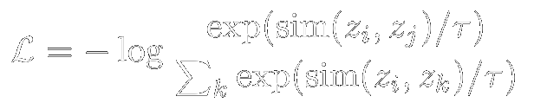
Contrastive Learning
x_i
f(·)
z_i
Image x
augment
→
→
→
InfoNCE
↗
↘
attract z_i, z_j
f(·)
z_j
repel negatives
x_j
Maximize agreement between positive pairs, minimize with negatives
SimCLR
MoCo
BYOL / SimSiam
Large batch (4096+), strong augmentations, projection head. Simple but needs huge batches for negatives.
Momentum encoder + queue of negatives. Memory-efficient, works with small batches.
No negatives needed! Asymmetric architecture prevents collapse.
Notes:
Contrastive learning - learning by comparison. SIMCLR: 1. Create two augmented views of same image 2. Encode both 3. Push them together (positive pair) 4. Push apart from other images (negatives) MOCO: Memory bank of negatives BYOL: No negatives needed!

Slide 36
Masked Autoencoders (MAE)
Encoder
Decoder
→
→
ViT
→
small
→
visible only
+ mask tokens
Original
75% masked
Reconstructed
High Mask Ratio (75%)
Asymmetric Design
Pixel Reconstruction
Unlike BERT (15%). Images are redundant, need harder task. Forces learning of semantics, not just interpolation.
Large encoder (ViT-L/H) sees only visible. Small decoder reconstructs. 3x faster training than ViT alone.
MSE loss on normalized pixel values of masked patches. Simple but effective.
Why Self-Supervised Learning Matters
Unlabeled data is abundant and cheap
Labels are expensive (medical: expert hours)
Pretrain once, fine-tune for many tasks
Foundation model paradigm
Notes:
Masked Autoencoder - BERT for images. THE RECIPE: 1. Mask 75% of patches 2. Encode only visible patches 3. Reconstruct masked patches WHY 75%? Images are redundant, need hard task. FOUNDATION MODEL PARADIGM: Pretrain on unlabeled data → fine-tune with few labels. This is how modern AI is built!

